Slide 1
Putting the Pieces Together: Sketching a Hybrid Faith Formation Plan In Your Congregation
Now the fun begins; let your imagination take over!
Thanks to Leif Kehrwald @Vibrant Faith for some of the slides in this presentation.

Slide 2
Reimagining Faith Formation
Lifelong & Lifewide
Intergenerational & Generational
Networked
Missional
Connected & Blended
Personalized
Curated

Slide 3
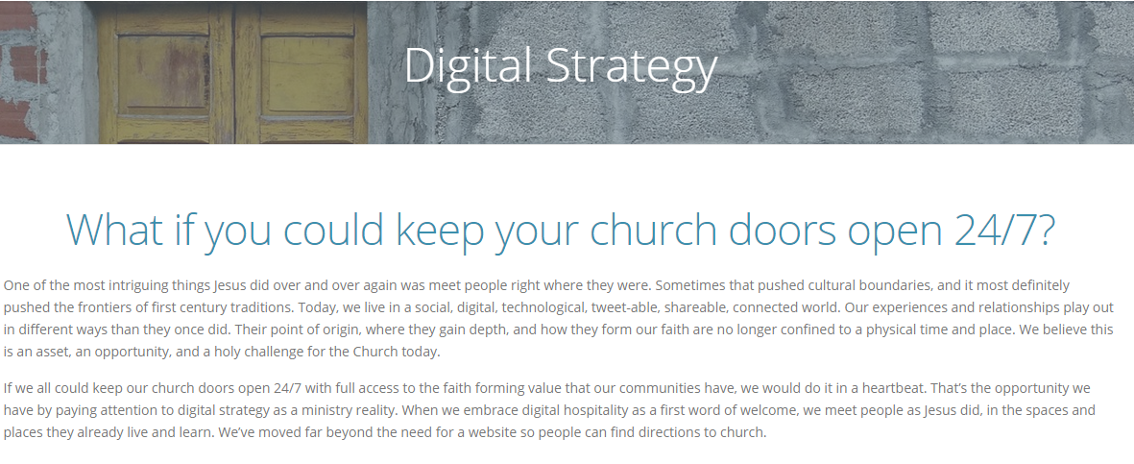
www.vibrantfaith.org

Slide 4
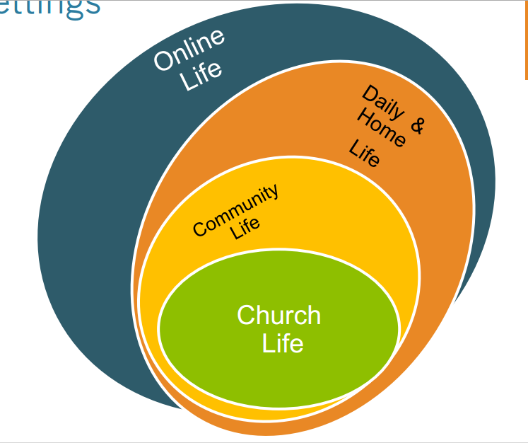
www.vibrantfaith.org

Slide 5
Where Can The Circles Blend Together? = Hybrid Faith Formation
Church Life Daily/Home life via Online life
Online Life Daily/Home life Church Life
Community life Daily/Home Life via Online Life
Online Life Church Life Daily/Home Life
www.vibrantfaith.org

Slide 6
Three Seasons of Programming
Fall Season: September 1 – January 1
Winter/Spring Season: January 1 – May 1
Summer Season: May 1 – September 1
Fall
Winter-Spring
Summer
www.vibrantfaith.org

Slide 7
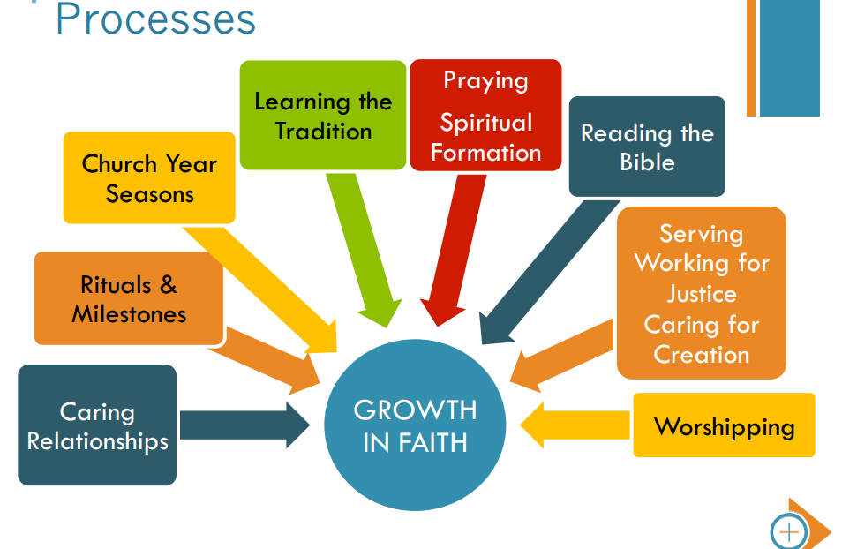
www.vibrantfaith.org

Slide 8
Imagine doing 1 component of 1 of any of these 8 processes online instead of in person, or in combination with in person!

Slide 9
www.vibrantfaith.org

Slide 10
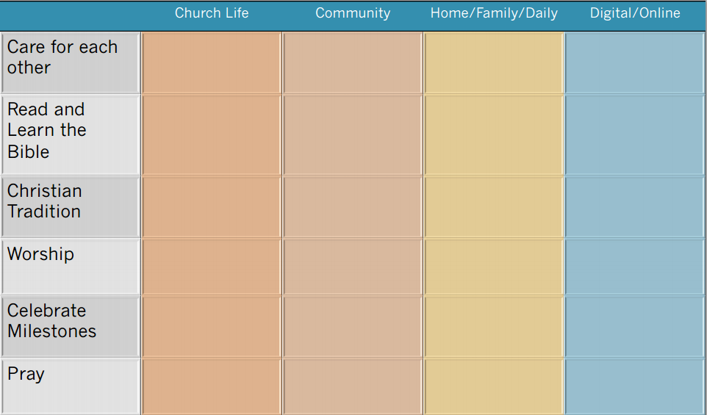
www.vibrantfaith.org

Slide 11
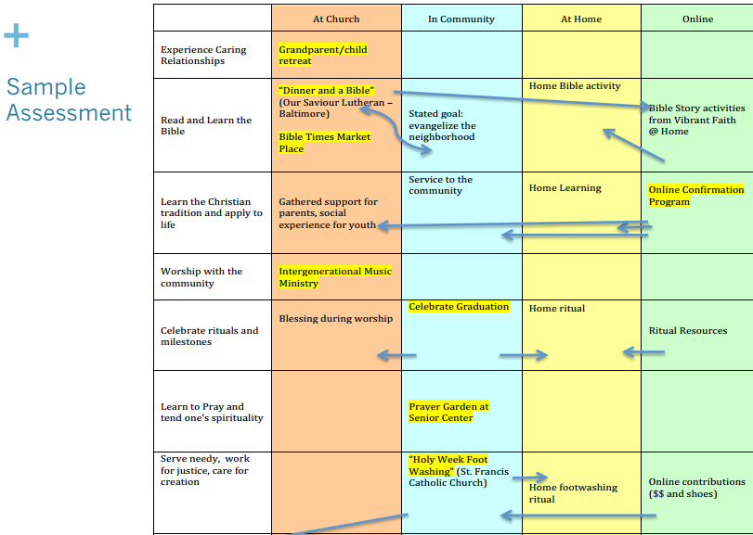
www.vibrantfaith.org

Slide 12
Observe/Discuss
What does this tell you about where faith happens?
What does this tell you about how faith happens- experiences/processes
When you look at your list of faith formation programs in your congregation, what settings do you utilize?
How might your parishioners better experience God’s living presence in the community?
How can you meet people “where they are at” in life?
www.vibrantfaith.org

Slide 13
Come up with a plan that will not overwhelm you:
What’s lacking on your grid?
What can be extended to other settings?
Adopt examples shared?
Concrete goal for A season, for ONE group, for ONE area

Slide 14
Advice
Don’t get overwhelmed! Get one idea and run with it
Learn from your mistakes
Network and commiserate with each other
Celebrate what works and share with others
www.vibrantfaith.org

Slide 15
First Step Ideas:
Lent tweet, embed SSJE, Lent in a Bag
Flat Jesus this summer
Virtual Group- teens? Some segments of adults?
Add a link to a weekly email to parents with a video reflection
Curate some online resources?
Parents’ Baptismal preparation program which includes a closed online discussion group before the parents meet IRL (in real life) at the parish.
Other?

Slide 16
Digital Revolution
Good?
Bad?
Here to stay.. And grow
It changes everything!

Slide 17
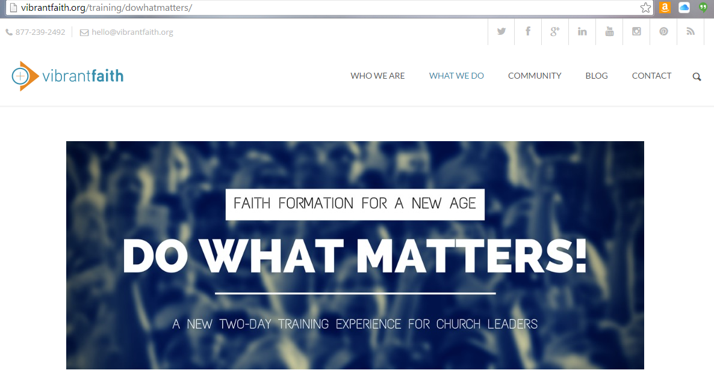
Do What Matters - Twin Cities - April 14-15 Eden Prairie, MN

Slide 18
E-Formation 2015
June 1-3, 2015
Virginia Theological Seminary
or participate via webinar
http://www.eformationvts.org/about-e-formation-2015/

Slide 19
5 Characteristics of an Online Presence that is Ministry
Sr. Susan Wolf, SND April 15, 2014
www.catholicwebsolutions.com

Slide 20
Not every religious/ministry presence online is a quality presence!
- It is simply not enough to be online–we have to be online with a vision and a purpose that is joyful and faithful.

Slide 21
Our Prayer for the People We Serve
“It is very easy to forget why we have taken on this new web ministry. We can get caught up in the learning curve, the deadlines, the distractions, and stop or never start to pray over what we are doing and why we are doing it. We can forget to pray for the people we might touch through this ministry—to pray that our words and images truly communicate God’s love to them and our love as well.”
“We can even forget that “The principal agent of evangelization is the Holy Spirit.”

Slide 22
As we get ready to move forward…

Slide 23
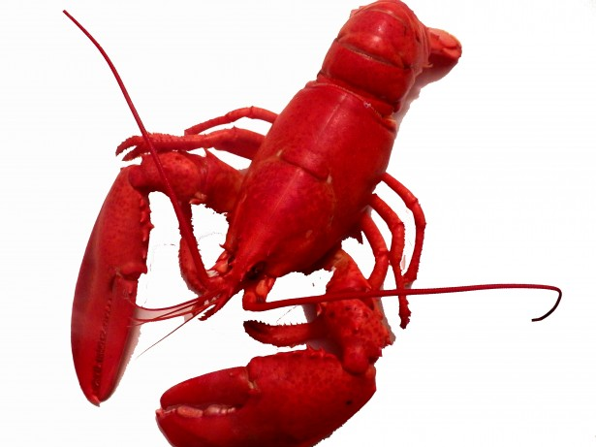

Slide 24
Adaptive Presence
How can you open up in vulnerability;
shedding your old shell?
What kind of courage is required to risk blindness & exposure as you move forward?
How can you take in the context around you so that something new might emerge?
How might your congregation become an adaptive community, able to surrender prior structures while calling forth new practices?

Slide 25
www.vibrantfaith.org

Slide 26
www.vibrantfaith.org

Slide 27
www.vibrantfaith.org

Slide 28
www.vibrantfaith.org

Slide 29
www.vibrantfaith.org

