Slide 1
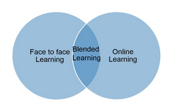
In-Person + Online =
Hybrid Faith Formation
Thanks to Kyle Oliver from the
Center for the Ministry of Teaching- Virginia Theological Seminary
for providing some of the slides for this presentation.

Slide 2
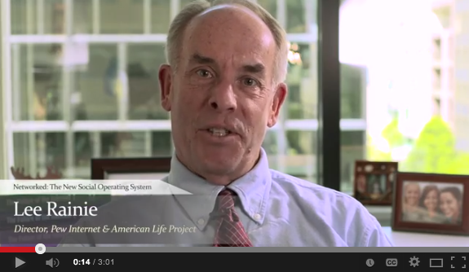
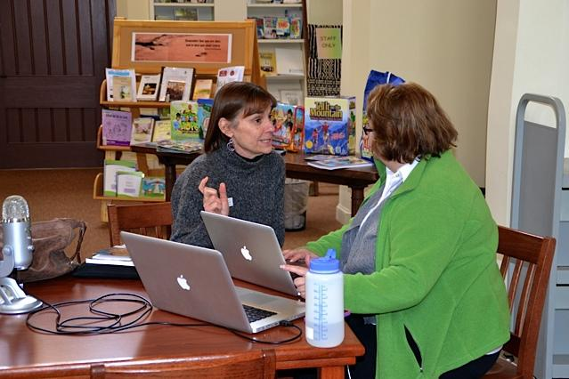
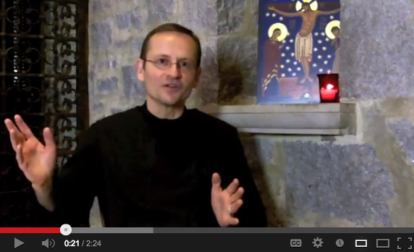
Background: How did this get started?
Pilot: Who’s doing it and how’s it going?
Resources: What do you need to get started?
www.vts.edu/cmt

Slide 3
Background
How did this get started?

Slide 4
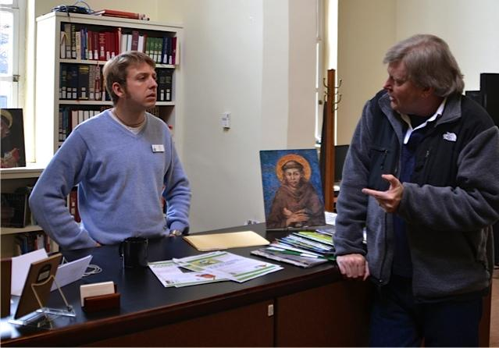
Problem: “What do you we do with the people who won’t come every week?”
Kyle found that the CMT desk is a great barometer of faith formation challenges and trends.
www.vts.edu/cmt

Slide 5
Proposal: Combine in-person meetings with connected online learning
identify shared interest and connect via digital “hub”
gather for monthly in-person meetings to build community and introduce important concepts and skills
participate in weekly activities at home and discuss them via the “hub”
www.vts.edu/cmt

Slide 6
Solution: combine FF networks with small groups
Social Media has changed the way people obtain information
“Networked individuals” learn things and share online- encourage individuals to create & share content
Personal relationships have been expanded beyond households and neighborhoods;
Mobile connectivity keeps people connected anywhere
To learn more about FF networks, check out John Roberto’s Faith Formation 2020 project.
www.vts.edu/cmt

Slide 7
Complication: How do you actually plant a church FF network?
Day Smith Pritchartt to CMT: “How would that actually work?” CMT decided to find out.
www.vts.edu/cmt

Slide 8
https://www.youtube.com/watch?v=QZpzF5O0F8s
Randall Curtis’ summary of hybrid faith formation

Slide 9
* Part of the inspiration for CMT in this area was the work of faith formation visionary John Roberto.
* John’s mantra for twenty-first-century ministry is “Don’t start a program, build a network.”
* So rather than saying “please come to this year’s Wednesday night class about ______,” leaders of hybrid faith formation networks respond to the organic connections, spiritual needs, and learning goals already in place among members of the congregation, and possibly others. (hockey moms)

Slide 10
Pilot
Who’s doing it and how’s it going?

Slide 11
Learning community: Parishes/dioceses connected with the CMT
CMT-led network
Topic: leading networks
P
P
P
L
L
P
P
P
P
P
P
L
P
P
P
P
P
P
P
P
L
P
P
L
P
P
P
P
Parish/diocesan
networks Topics: varied
P
P
P
P
www.vts.edu/cmt

Slide 12
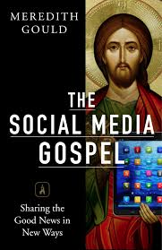
Curriculum: Leader network focused on pedagogical, digital, logistical concerns
http://faithformation4-0.com/resources/eformation-resources
www.vts.edu/cmt

Slide 13
Faith Formation 1.0-4.0
1.0 Oral Communication - Early Christian communities efforts to keep and tell Jesus’ story
2.0 Written Communication – 50 AD letter attributed to Paul, letters, scrolls, painting on tomb walls, icons after Edict of Milan legalized Christianity and brought it out from hiding
3.0 Mass-Mediated Communication – mass distribution of material; Gutenberg press, missionaries eagerness to education the general population, growing geographically dispersed population desiring access to information, radio, television, televangelists, cable show
4.0 Interactive Media Communication- individuals not only receive communication but can respond, can connect 24/7/365

Slide 14
We are in the midst of a cultural shift
Plato argued that writing would disconnect people from the important presence that comes with face-to-face interactions
When the bicycle was first produced, it was critiqued. Churches condemned this new technological mode of transportation for they saw it disconnecting people from their local community and distracting them with the dangers of the outside world: e.g. the cinema and roadhouses.
The automobile also received criticism about creating social distance and an acceleration of culture.
About the same time, in 1926, the Adult Education Committee of the Knights of Columbus investigated another emerging technology: the telephone. Their meetings were dominated by questions, such as,
“Does the telephone make men more active or lazy?”
“Does the telephone break up home life and the old practice of visiting friends?”

Slide 15
For a real-life, humorous look at the paradigm shift we are experiencing:
Kids React to Walkmans
How do we respond to the cultural shifts in our ministry?

Slide 16
Participants: We had a wide variety of parishes/dioceses, topics in 2013*
Position | Gender | Lay or Ordained? | Context | Network Convened
Minister for families (staff) | Female | Lay | Pastoral-sized suburban parish | Faith at home for families
Former leader of Christian education committee and current parish council officer (volunteer) | Male | Lay | Urban parish making transition from pastoral- to program-sized | Spiritual practices for participants in parish fellowship dinners program
Faith formation officer (staff) | Female | Lay | Mid-sized Mid-Atlantic judicatory | Skills for digital faith formation for leaders in parishes
*Read more about the pilot program here (general audience) and here (academic).
www.vts.edu/cmt

Slide 17
Participants: We had a wide variety of parishes/dioceses, topics in 2013
Assistant pastor (staff) | Male | Ordained | Corporate-sized suburban parish | Group bible study for individuals; general online learning program for individuals
Minister for youth (staff) | Female | Lay | Program-sized suburban parish | Idea exchange for parish teachers; faith at home for Sunday School parents
Assistant pastor (staff) | Male | Ordained | Program-sized suburban parish | Faith at home for families
Minister for children and youth (staff) | Female | Lay | Corporate-sized suburban parish | Faith at home for families
www.vts.edu/cmt

Slide 18
Participants: 2014 cohort larger, more denominationally diverse, more active
nine leaders from four denominations
revamped learning outline has more structure, more variety, lower time requirement
2013 “star participant” Day Smith Pritchartt now a cohort co-leader
Read more about the group from Kyle’s Posts on ECF http://www.ecfvp.org Search for “hybrid faith formation”
www.vts.edu/cmt

Slide 19
Shutting Down Sunday School- Day Smith Pritchartt
What would you do if:
the families in your parish were exceptionally regular in their attendance at worship, but only a few were committed to church school;
the well of prospective teachers was truly dry;
you had a Vestry who was willing to take risks and try new things, and a Rector who had your back at all times and in all places; and
Virginia Seminary’s Digital Missioner Kyle Oliver and CMT Director Lisa Kimball dared you to try something different (and promised to help)?
What did we do? We shut down Sunday school. Let me clarify: We adopted a pilot program of online faith formation, and we suspended our Sunday morning classes. St. Andrew’s FISH program (Families Integrating Sunday and Home) began in September.
http://www.keyhallonline.org/profiles/shutting-sunday-school/

Slide 20
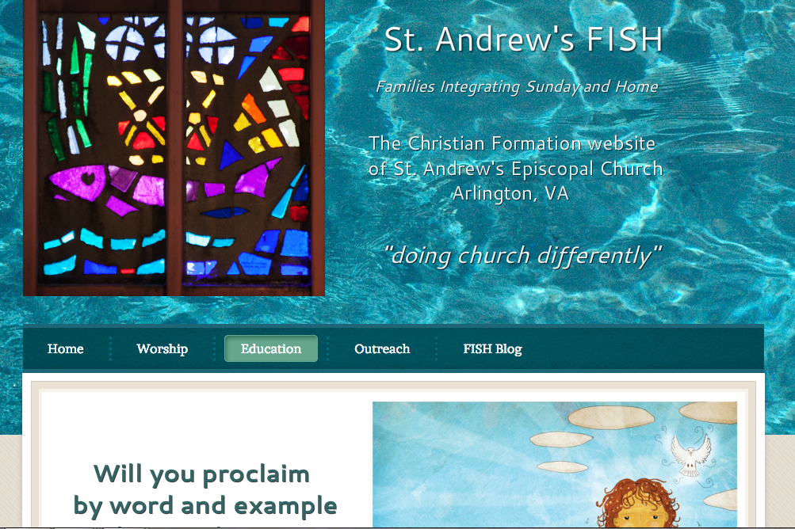
http://standrewsfish.weebly.com/

Slide 22
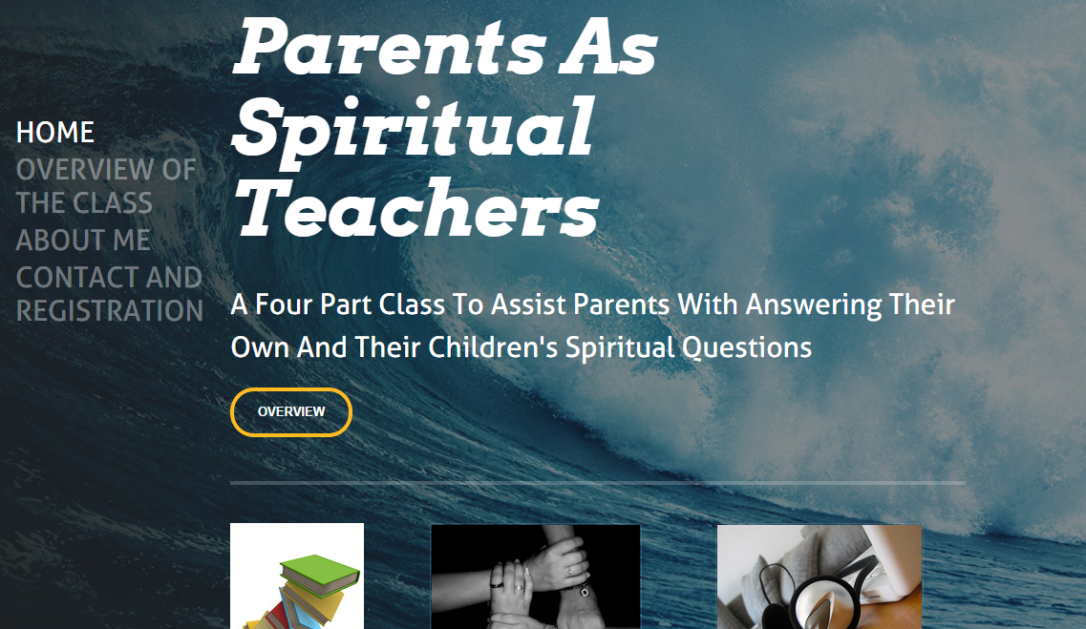
http://parentsasspiritualteachers.weebly.com/

Slide 23
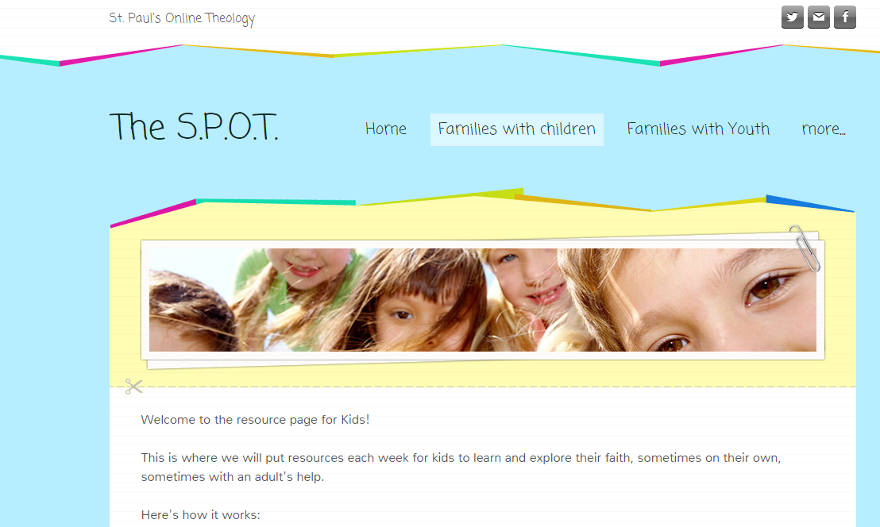
http://stpaulskcmo.weebly.com/
St. Paul’s Episcopal in Kansas City, MO, Megan Castellan gathers families for a similar program.

Slide 24
Warren Leibovitch, from St. Paul’s Anglican Church in Lindsay, Ontario started a Reaffirmation hybrid course online for adults, several of which are ages 65-75 and will engage youth in an online course for Confirmation in June.

Slide 25
Hillary West Epiphany Episcopal Church Oak Hill, Virginia
Five households of young families on their Christian Education Ministry Team decided the best way to enhance their Sunday School teaching was to share their comments and ideas from their teaching experiences each week by posting them.
They then reached out though on-line posting, to all young families sharing stories. Consequently, curriculum, teaching tips, etc. are now posted for all to peruse.

Slide 26
Roberta Dodds Ingersoll at First Presbyterian Church in Libertyville, IL
- Club M.O.M. already had some online infrastructure in place, so she focused on helping new members (the working moms) get to know the group online that had already been meeting in person.

Slide 27
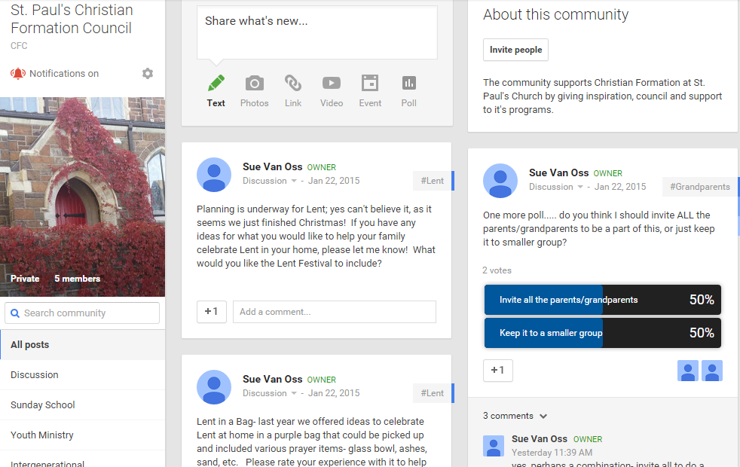

Slide 29
Resources
What do you need to get started?

Slide 30
Your role: Curate the content and the learning experience
Start small; cultivate a culture of learning
Balance your attention between content and community concerns
Start where there is curiosity, interest, hunger, or need
Get and share feedback

Slide 31
Content ideas: Choose content that gets people talking, thinking, doing
Vibrant Faith at Home
ChurchNext
Spiritual practices
Video programs from SSJE
Adapting traditional curricula (ECC, LtGN?)
Book or Bible study
Podcast (God Complex, On Being?) or video (Soul Pancake, Jason Chesnut, TED Talks? ) conversation
Don’t reinvent the wheel; you don’t have to create the content, you have to curate the content that’s out there!

Slide 32
Research and best practices: Work to build buy-in, enthusiasm
Choose a network hub that’s appropriate for your people—and help them get connected.
Make the most of your gathered events- can they be videod/handouts/reflections put online?
Be mindful of varieties of learning styles and generational differences (see Gould).
Don’t worry if it doesn’t take off right away—but do your best to invite engagement.
Find the “sweet spot” of clear structure and simple expectations.

Slide 33
Sharing online resources
“Breaking ground and sowing seed”

Slide 34
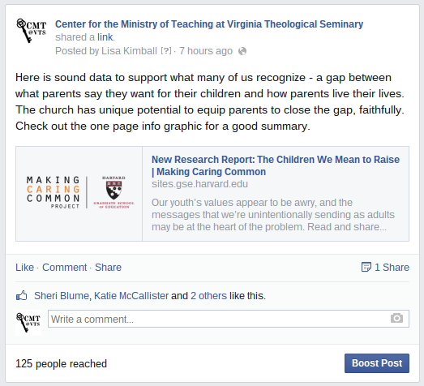
Get social: Networking with members lets leaders share resources
Don’t just share blind link; explain why resource matters
Consider suggesting a starting point
Tag interested parties in a comment, if appropriate
www.vts.edu/cmt
Notes:
**Activity: try it!

Slide 35
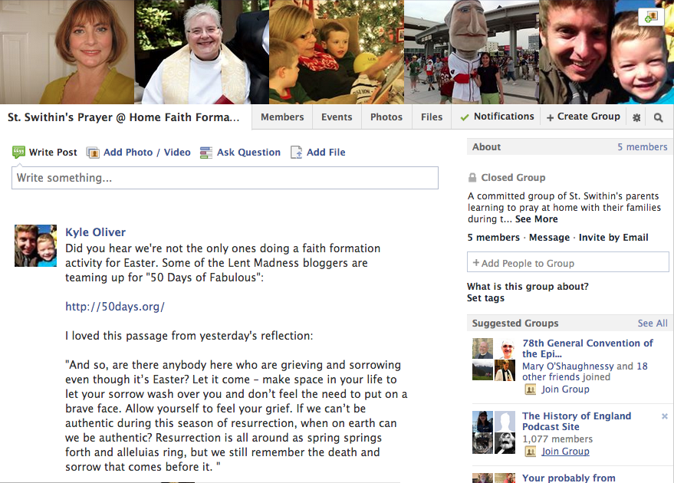
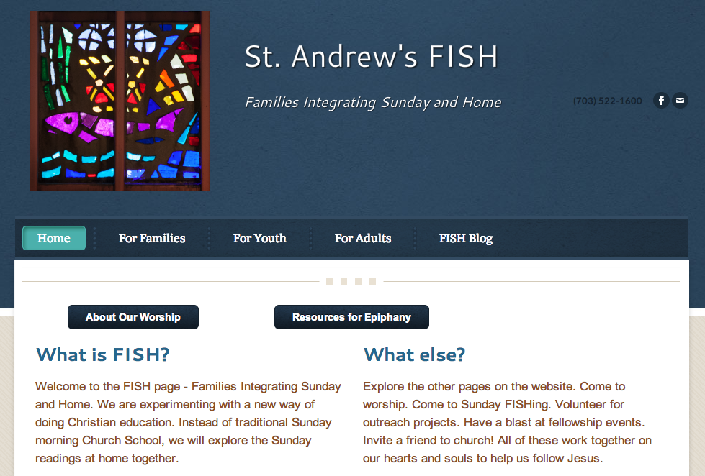
Tech demo: Three good options to build your hub are groups, blogs, listservs
www.vts.edu/cmt

Slide 36
Gather them in: Consider an online resource center for your congregation
Kyle’s list: more resource sources
www.stpaulsfaithformation.org - St. Paul’s Episcopal Church, Duluth
St. Columba’s Episcopal Church – spirit link

Slide 37
http://holytrinityfamilies. weebly.com/for-parents.html

Slide 38
What Have
We Learned?
Results of participant surveys

Slide 39
Different Ways to Integrate Online and In-Person
Some activities would be best done at home, and we knew in-person meetings would be essential for building trust and camaraderie.
We identified three models that seem to be working:
Gathering as launch: In this approach, the in-person gathering at church is meant to launch the group into several weeks of at-home faith practice. So perhaps they practice a new skill, like trying out types of prayer or reading scripture in a new way. Participants learn in a larger, more supportive setting and thus feel more confident when they have to try on their own.
Gathering as culmination: Flipping that trajectory, this approach uses a few weeks of at-home learning as preparation for a culminating activity in person. Day’s group at St. Andrew’s spent several weeks at home learning to tell the story of Abraham and then gathered for the opportunity to put on a play of the story they now knew so well.
Gathering as icon: Not mutually exclusive with the other two, this approach focuses the in-person gathering around creating a physical sign of the group’s shared learning, like a liturgical banner—or a play. This shared handiwork becomes an icon not just to the group, but to the wider church community.

Slide 40
Usefulness of weekly check-in posts
Asking the right question
Establishing a rhythm of interaction and follow-up.
Having a facilitator to keep things on track
- Our more important piece of learning—a reminder, really—is that the core skills and practices of ministry, including the ministry of faith formation, are the same as ever in this digital age: love the people you serve, encourage them to love and support one another, trust that God is present in the lives of all who seek transformation in the Spirit.

Slide 41
Community
The Power of Community to overcome the fear of Change
What kept us motivated was wanting to know what each other was up to; what was working, support each other in our efforts

Slide 42
Our Learners Are Not Students!
Members of our congregations aren’t students in the formal educational sense. Sure, they are growing disciples of Jesus Christ, but Jesus’ “students” weren’t enrolled in classes, weren’t paying tuition, weren’t receiving a grade or a diploma.
We have to find meaningful ways of motivating the learners in our congregations, because we don’t have the carrots of the school system, and the traditional cultural pressures to practice the faith no longer apply. (That’s okay; they were probably poor motivators of deep transformation anyway.)

Slide 43
Life Will Happen; Grace Should Abound
- One of the advantages of having leaders participate in a network at the same time that they were trying to launch one was the perspective that this experience gave.
Be realistic about how everyday pressures affect participants in the program. Don’t shame or guilt to try to coerce robust participation in our churches.
Those who stuck with the experience and those who had to bow out agreed that the group’s whole-hearted support of their adult decisions about participation were important to the overall experience. “Accountability” has become something of a buzzword in ministry. But let’s not send the message that anything less than full participation is failure or some sort of betrayal.

Slide 44
If this model is interesting to your congregation, contact Kyle Oliver at cmt@vts.edu about joining a future cohort!
And check out e-Formation June 1-3, 2015!

Slide 45
Follow the Center for the Ministry of Teaching for HFF news & invites.
www.vts.edu/cmt/connect
www.keyhallonline.org
facebook.com/VTSCMT
facebook.com/eformationvts
twitter.com/VTS_CMT
vts-cmt.tumblr.com
pinterest.com/vtscmt

