Slide 1
Episcopal Youth Music Camp 2013
August 4th-10th, 2013

Slide 2
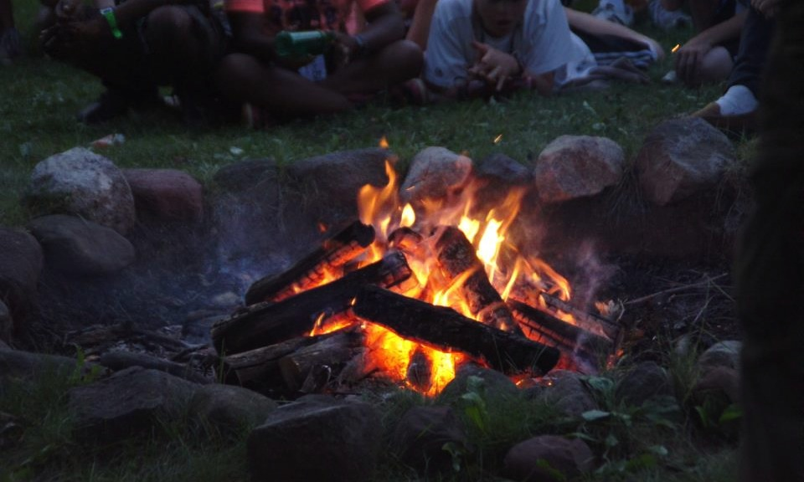
Camp Ministry Changes Lives

Slide 3
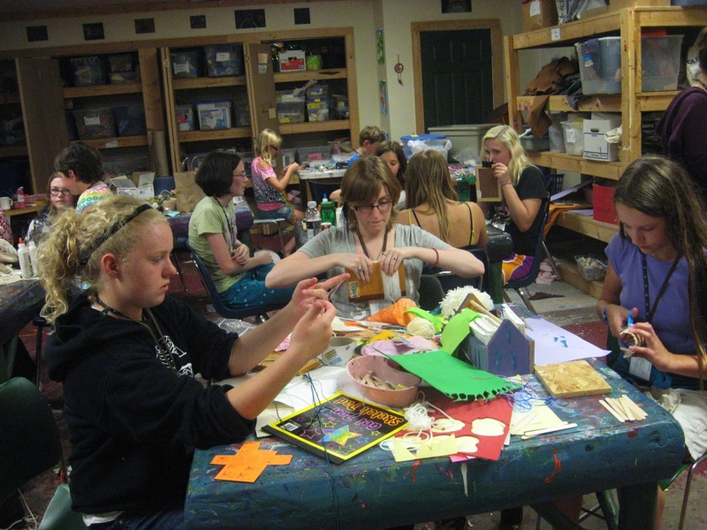
EYMC is open to 3rd-12th graders

Slide 4
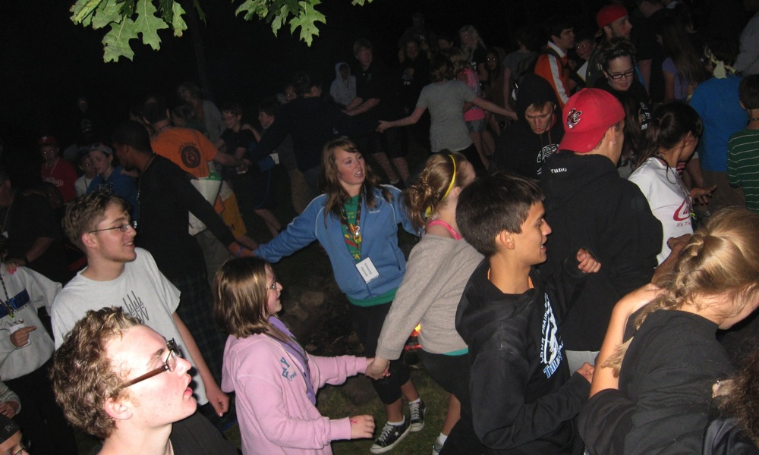
Camp Activities include…

Slide 5
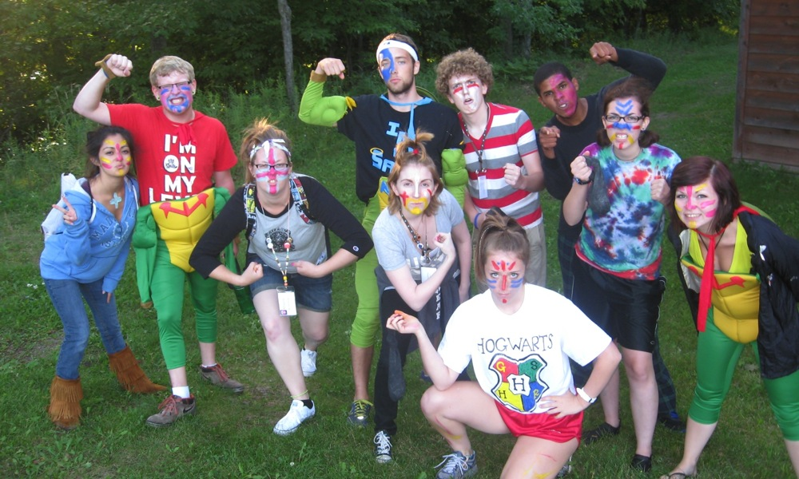
Outdoor Games

Slide 6
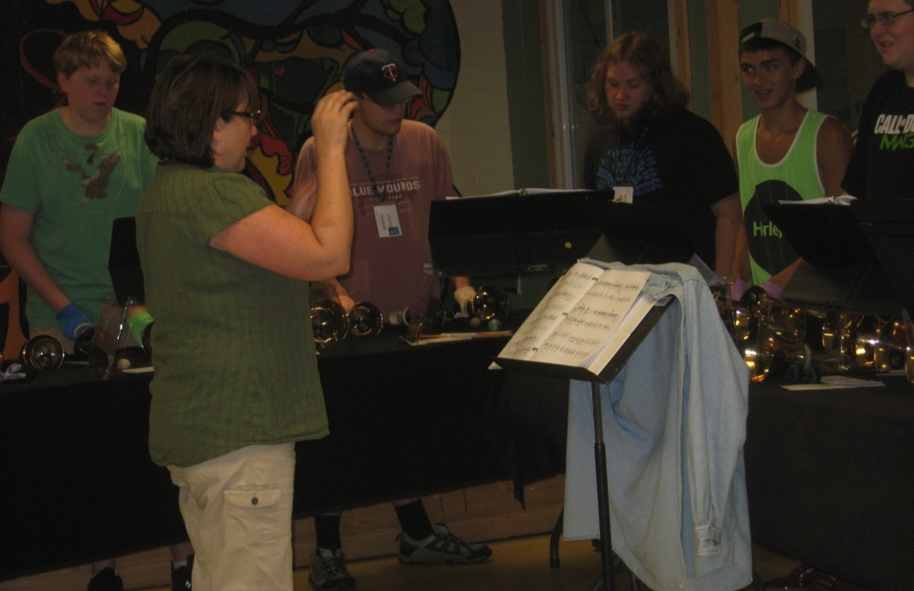
Handbells

Slide 7
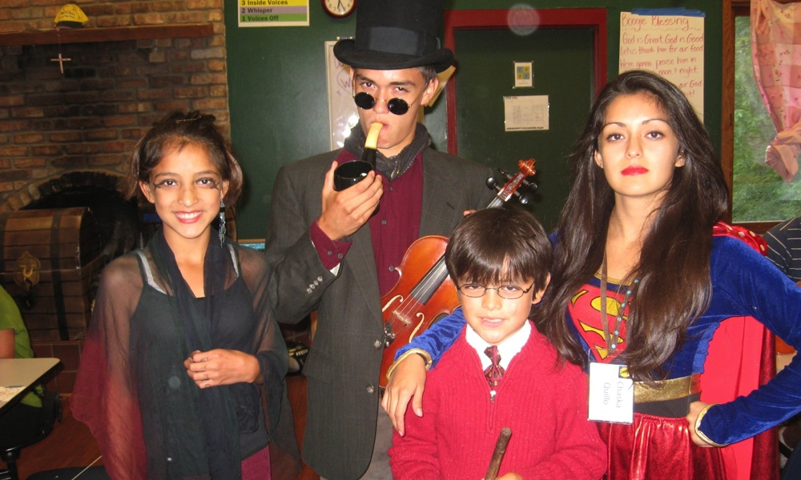
Theme Dinners

Slide 8
Camp Musical

Slide 9
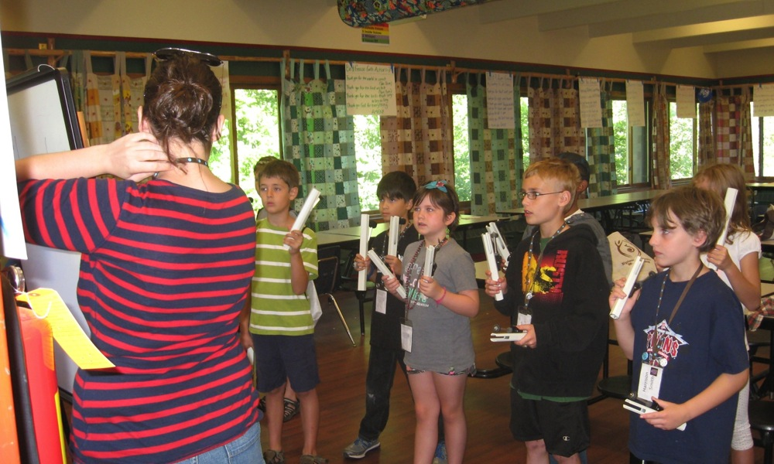
Chimes

Slide 10
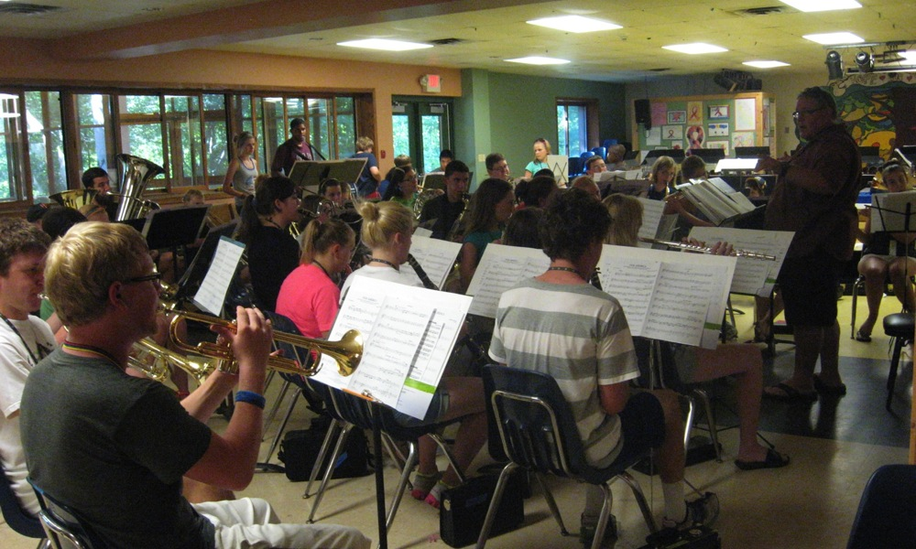
Band

Slide 11
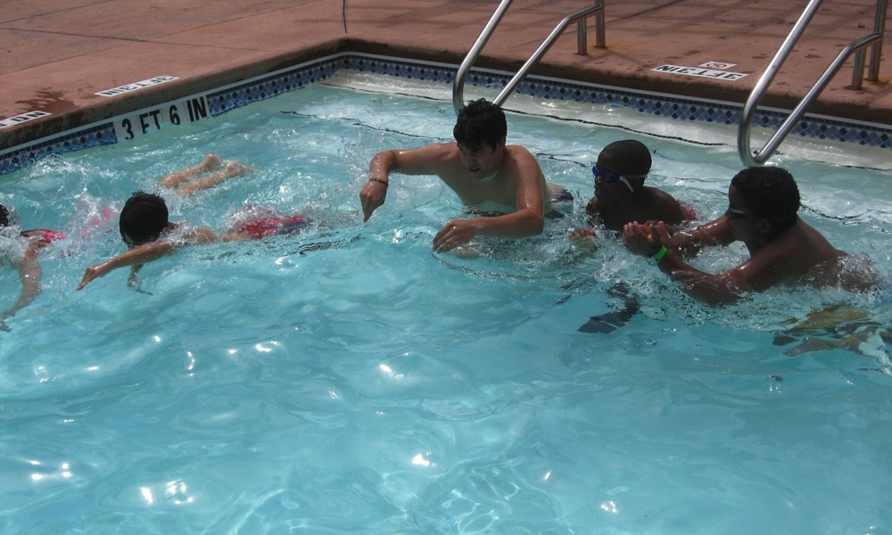
Pool Time

Slide 12
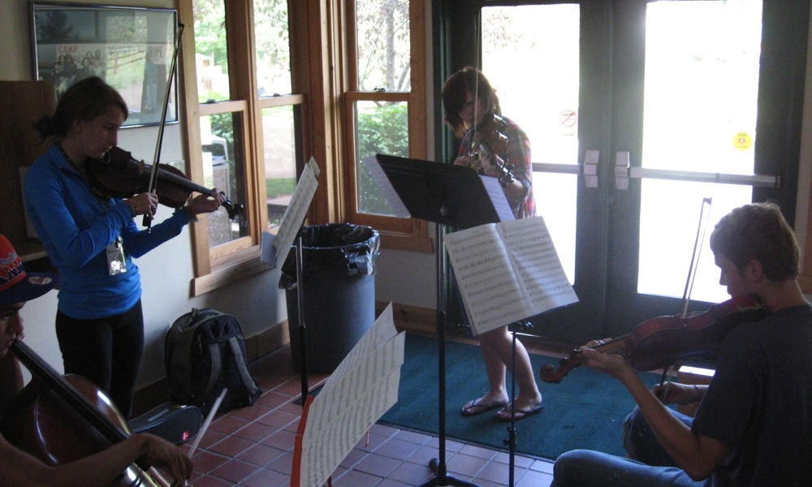
Orchestra

Slide 13
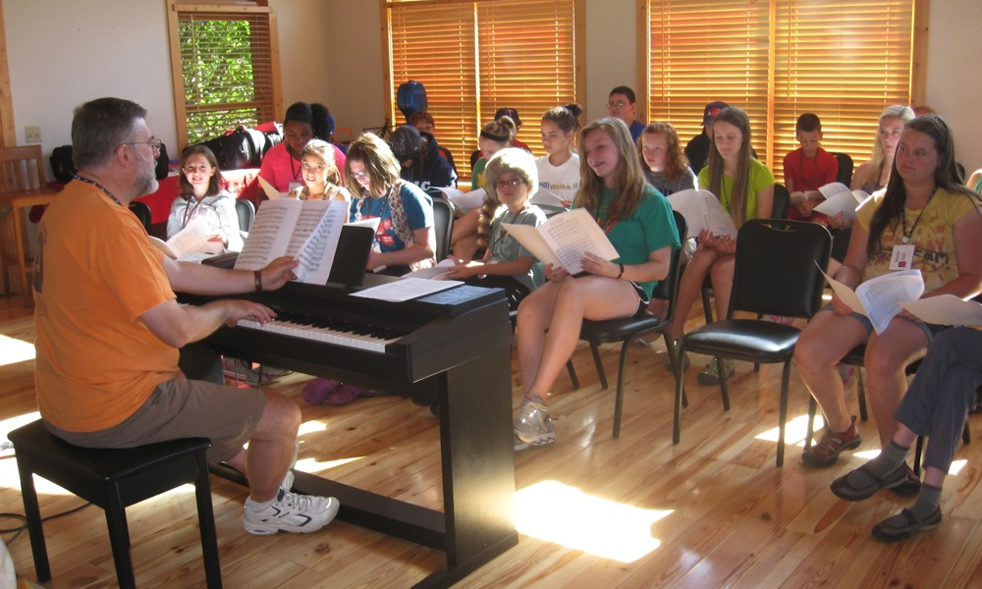
Choir

Slide 14
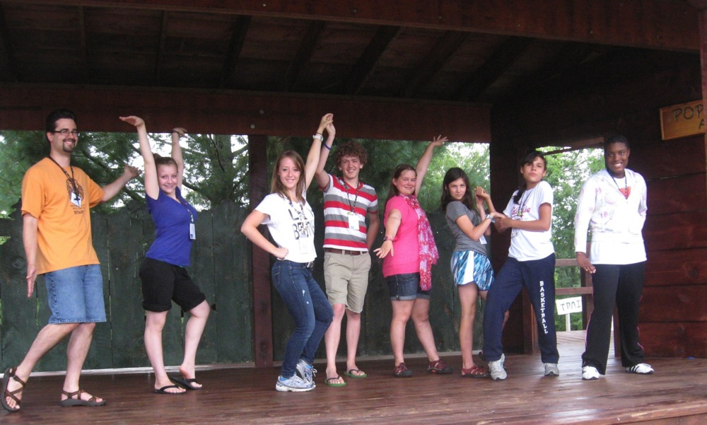
Dance

Slide 15
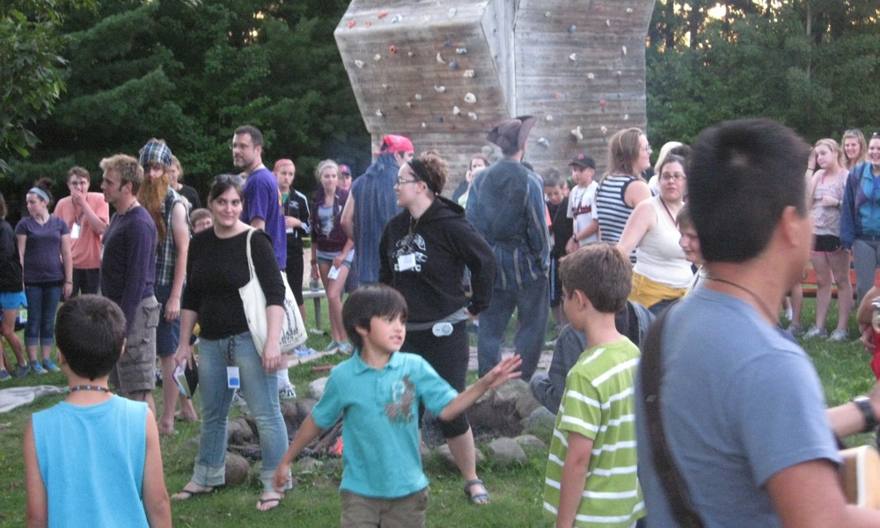
Campfire

Slide 16
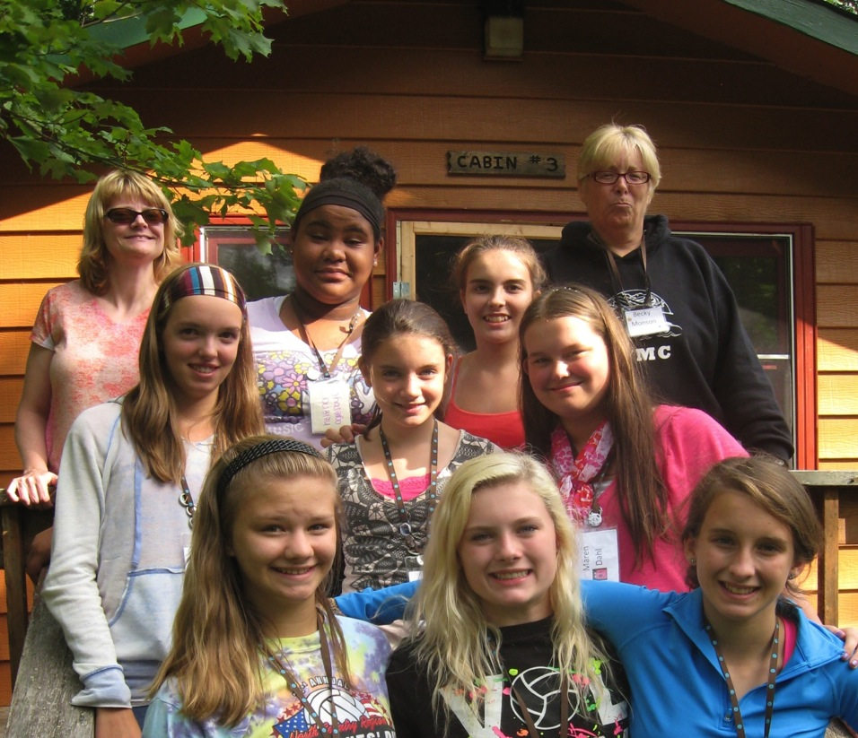
Cabin Bonding

Slide 17
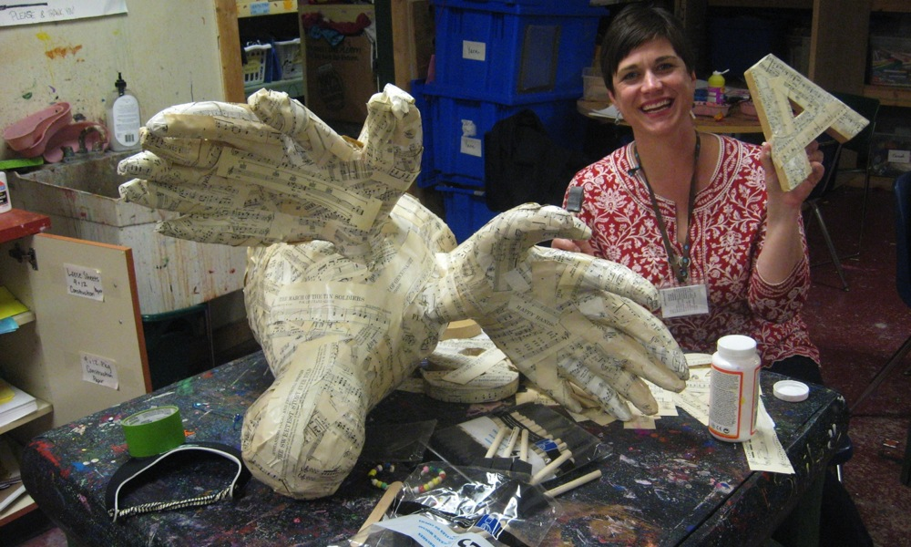
Arts and Crafts

Slide 18
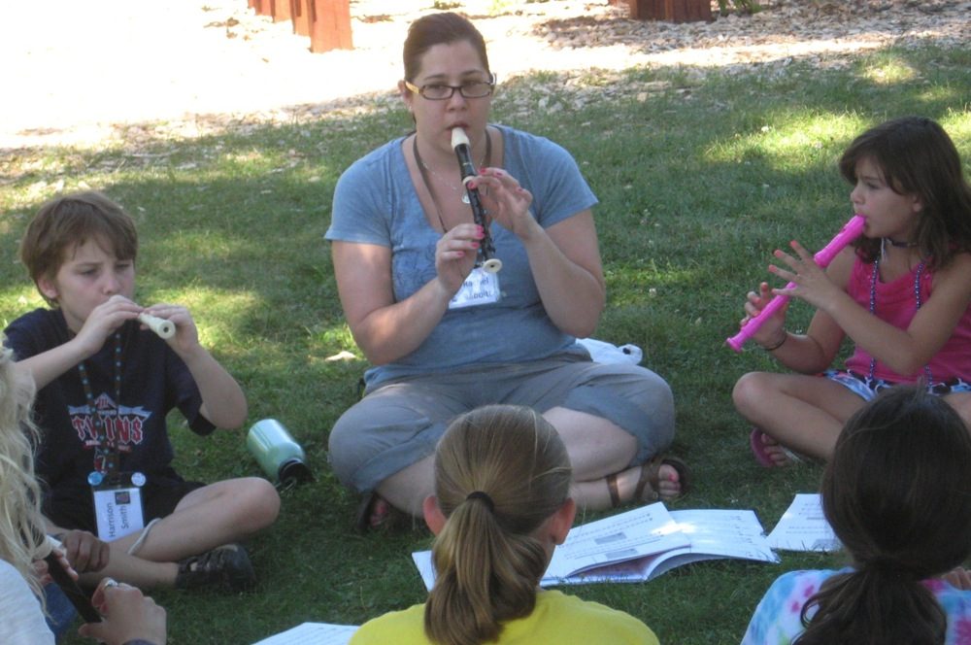
Recorder

Slide 19
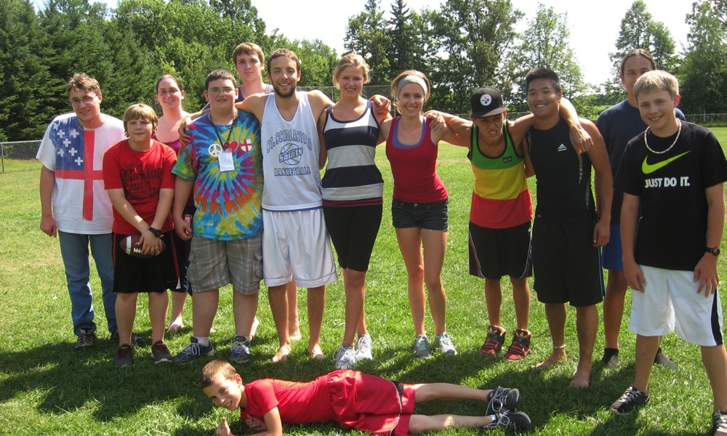
Football

Slide 20
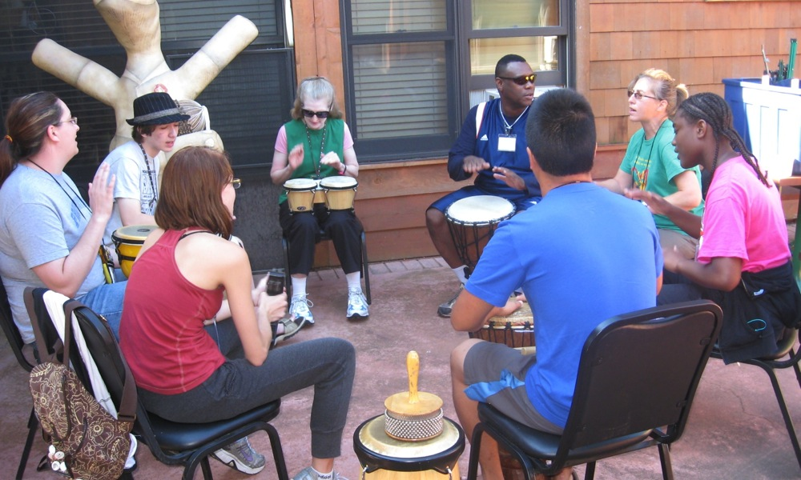
Percussion

Slide 21
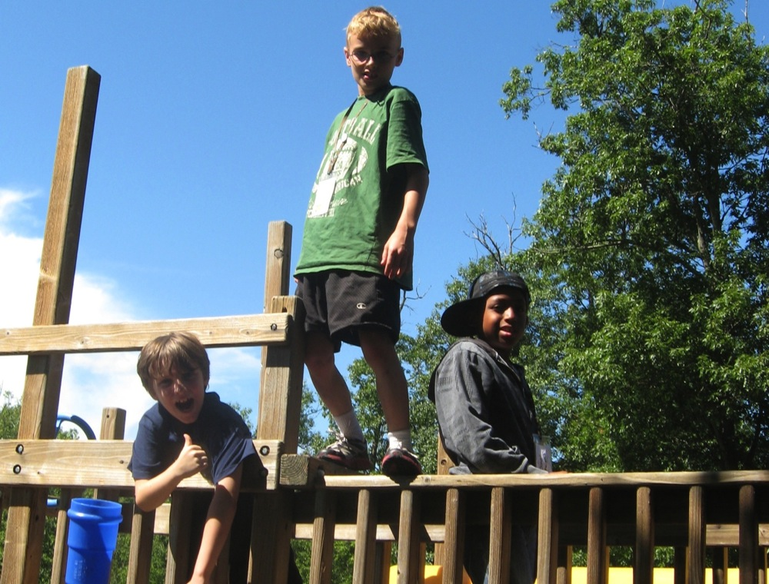
Playground

Slide 22
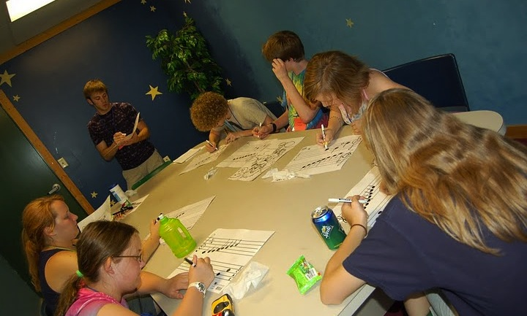
Music Theory

Slide 23
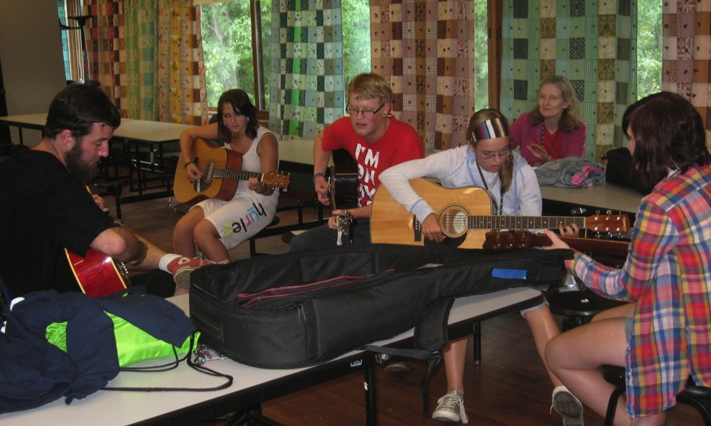
Guitar

Slide 24
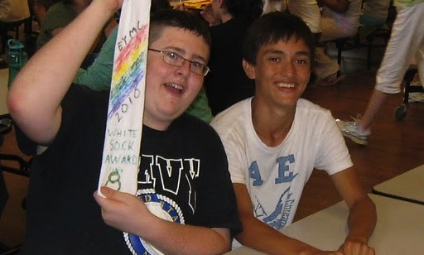
White Sock

Slide 25
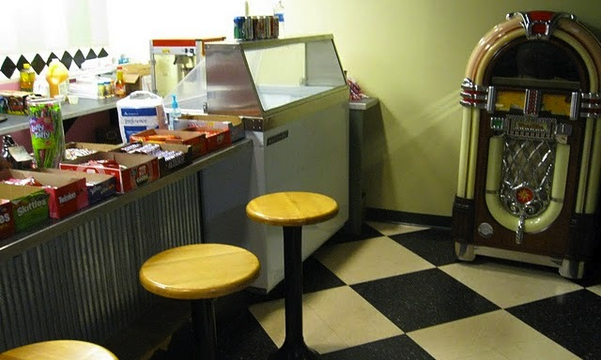
Canteen

Slide 26
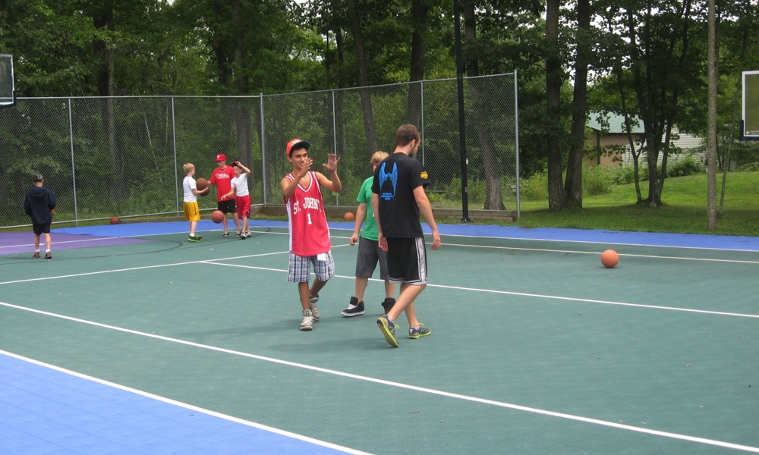
Basketball

Slide 27
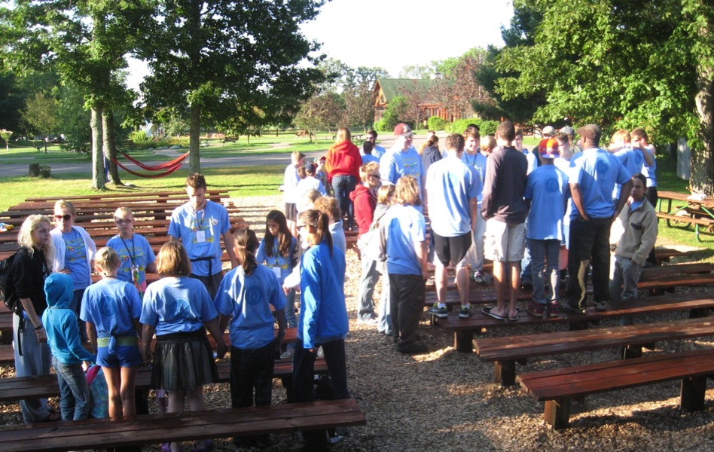
Worship

Slide 28
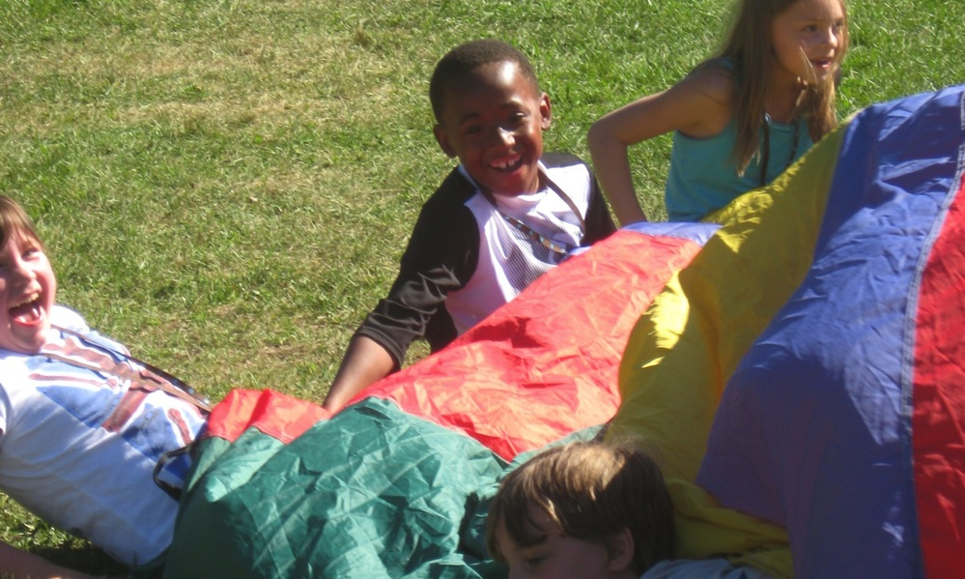
You don’t need to be “musical” to attend EYMC

Slide 29
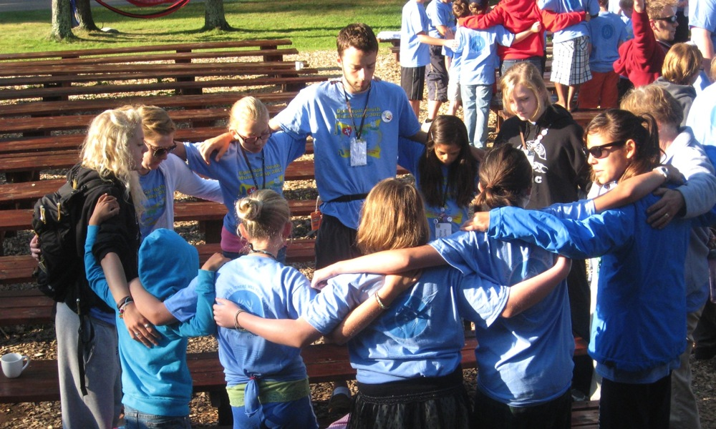
God is at the Center

Slide 30
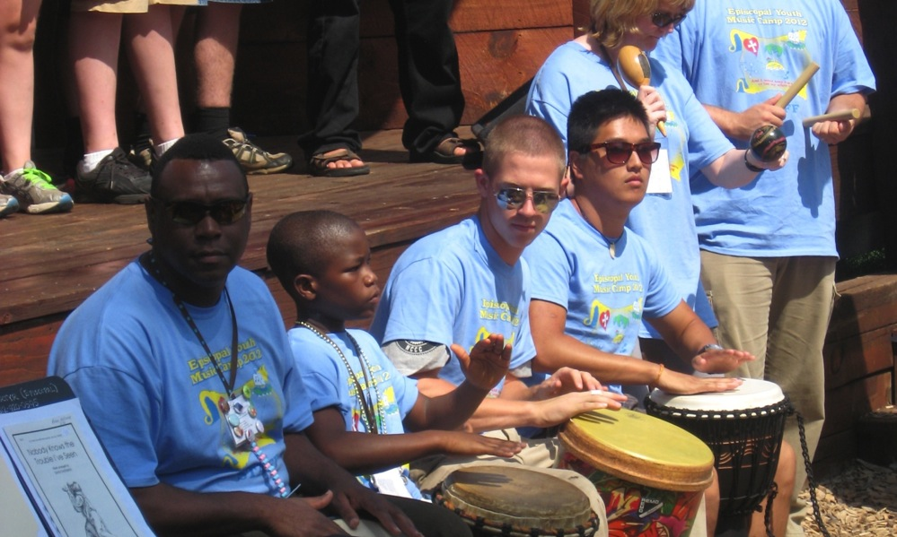
We learn about God and each other through music

Slide 31
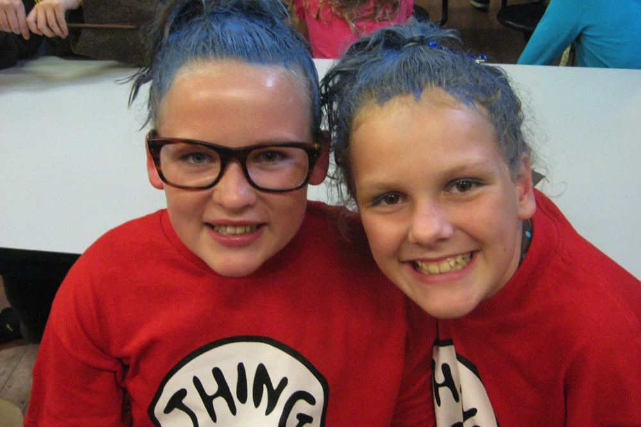
Camp builds Friendships

Slide 32
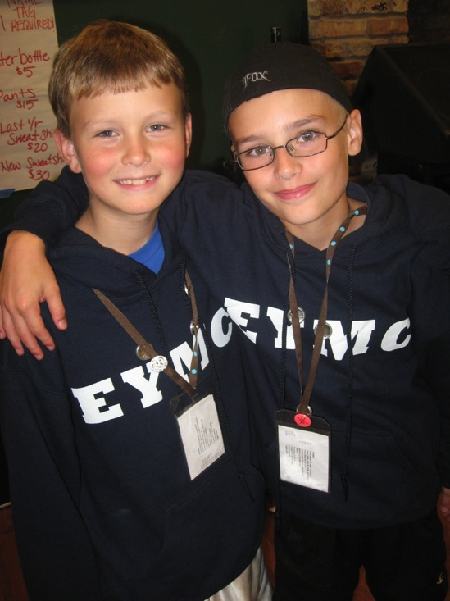
New Campers

Slide 33
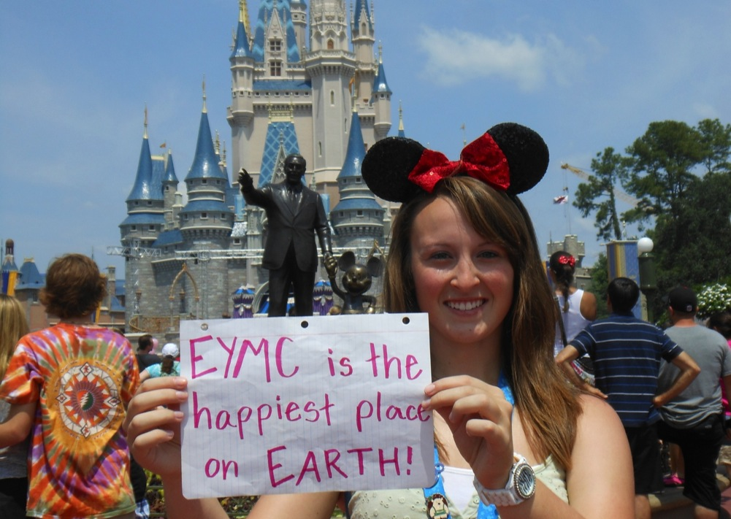
Returning Campers

Slide 34
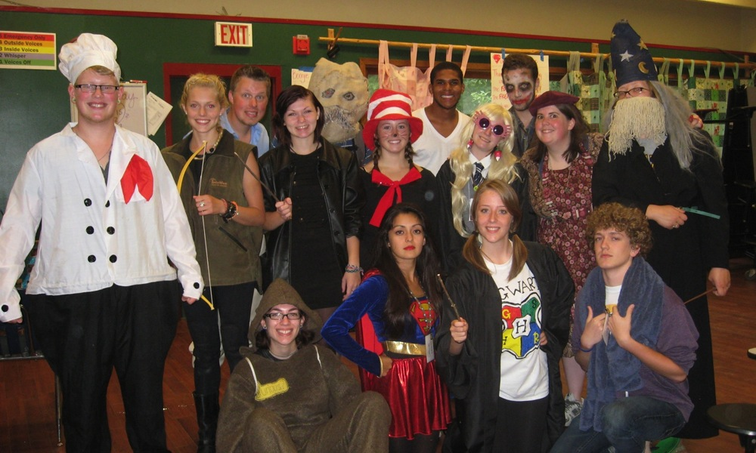
Camp Grows Leaders

Slide 35
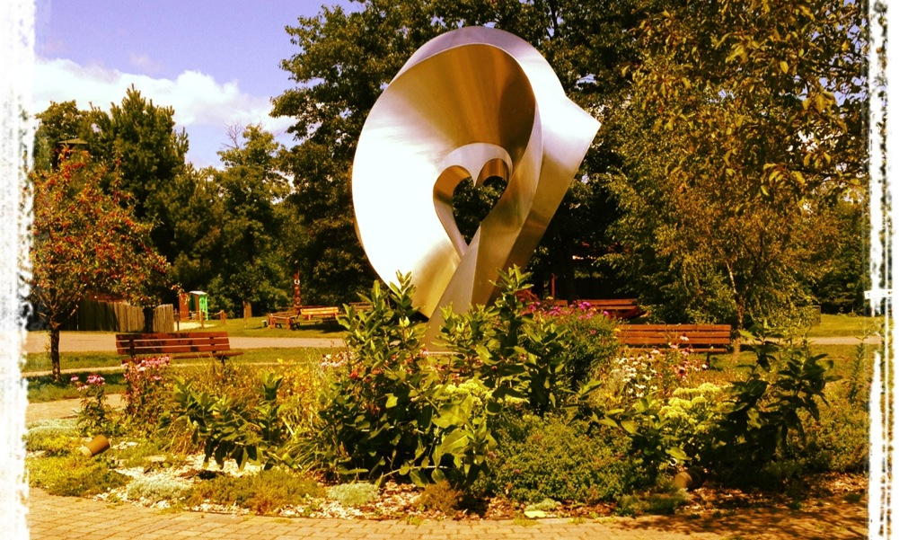
Our relationship with Camp Heartland

Slide 36
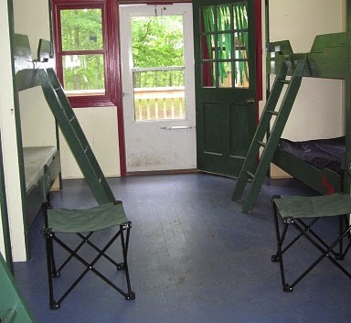
Cabin Moments

Slide 37
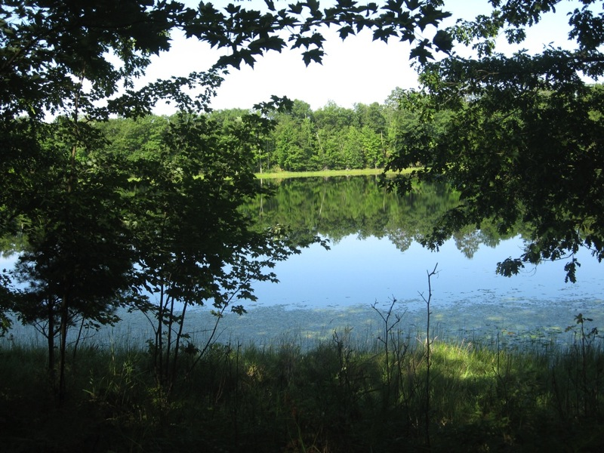
Quiet Moments

Slide 38
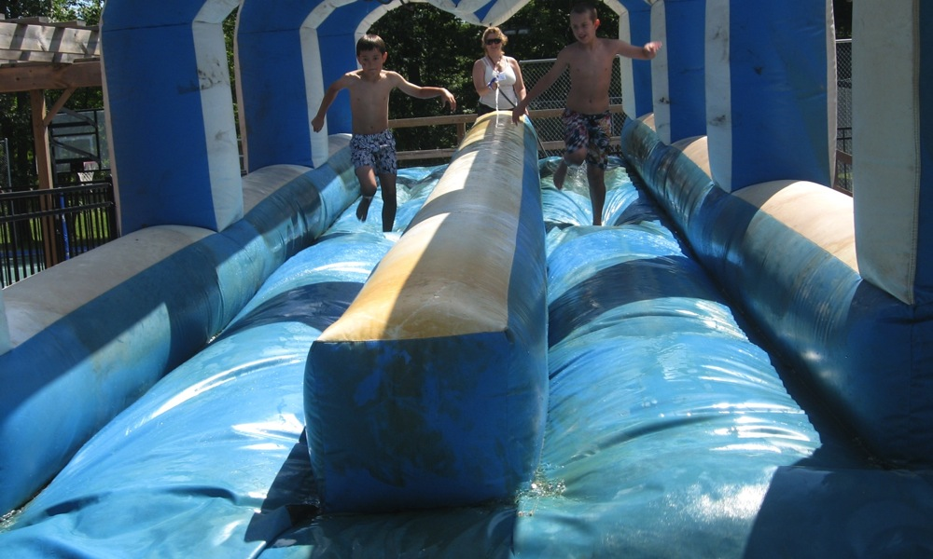
Crazy Moments

Slide 39
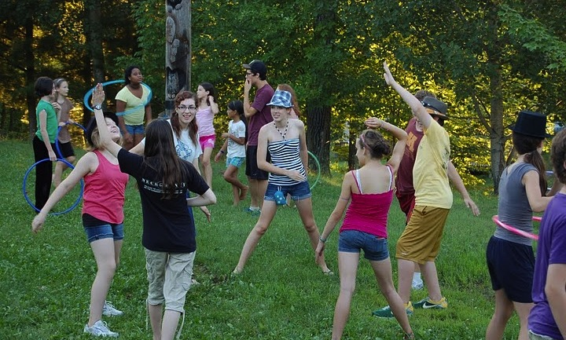
Camp Moments

Slide 40
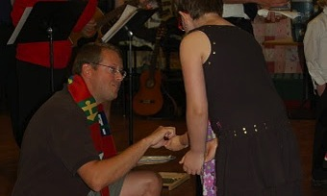
God in all moments

Slide 41
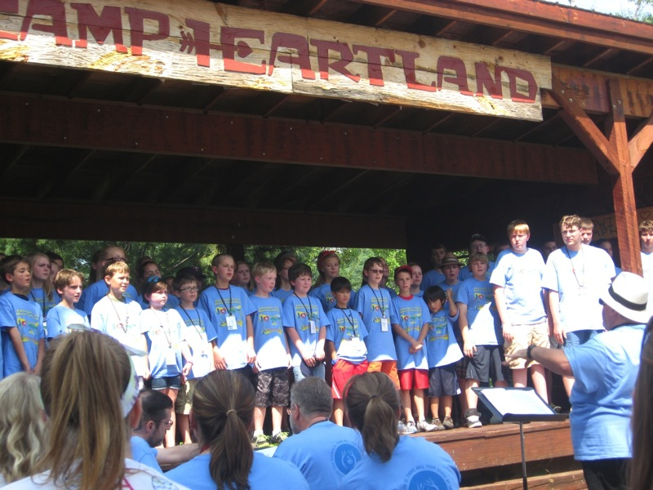
www.episcopalmn.org

Slide 42
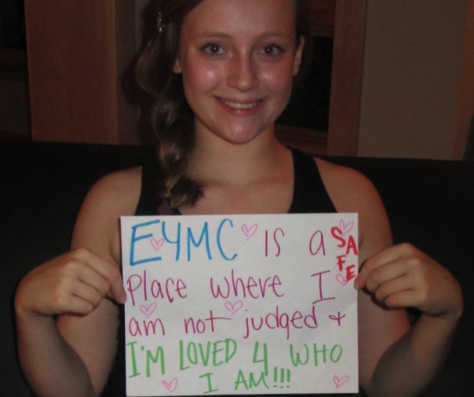
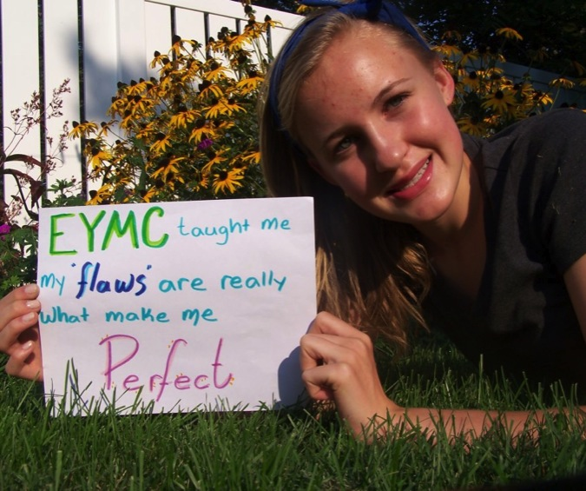
Why Camp?

Slide 43
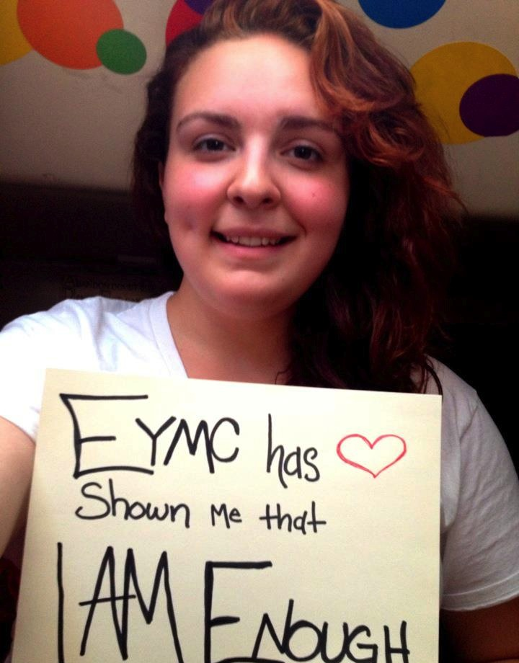
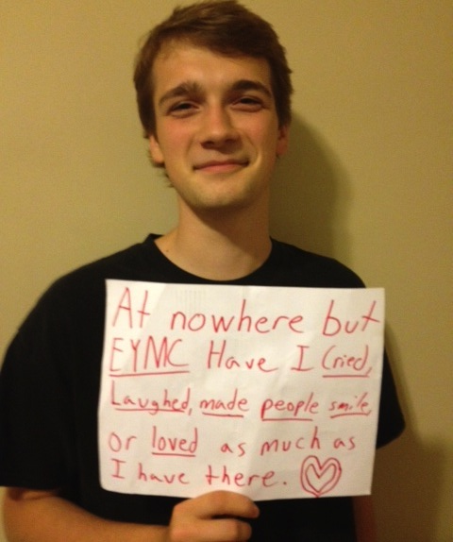
Why Camp?

Slide 44
Questions?
Alison Feigh, Chaplain/LT afeigh@gmail.com
Myles Heistad /LT co-cordinator
Willie Brakke, LT 2011 and 2012
Cedrik Cady-Hill, Camper for 5 years

